Slide 1

Lecture #9

Slide 2
Operating system by Saima Kanwal
Lecture # 9

Slide 3
Process
A process is defined as an entity which represents the basic unit of work to be implemented in the system.
To put it in simple terms, we write our computer programs in a text file and when we execute this program, it becomes a process which performs all the tasks mentioned in the program.

Slide 4
Process Life Cycle
When a process executes, it passes through different states.
In general, a process can have one of the following five states at a time.
Start
Ready
Running
Waiting
Terminated

Slide 5
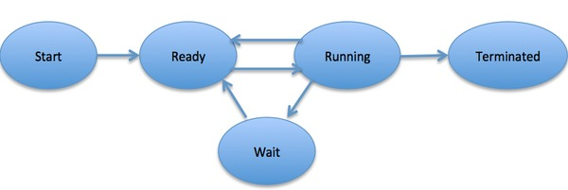
Process Life Cycle (Cont.)

Slide 6
Process Life Cycle (Cont.)
Start -- This is the initial state when a process is first started/created.
Ready -- Ready processes are waiting to have the processor allocated to them by the operating system so that they can run.
Running -- When the Process is Running under the CPU, or When the Program is Executed by the CPU , then this is called as the Running process

Slide 7
Process Life Cycle (Cont.)
Waiting -- Process moves into the waiting state if it needs to wait for a resource, such as waiting for user input, or waiting for a file to become available.
Terminated -- After the Completion of the Process , the Process will be Automatically terminated by the CPU . So this is also called as the Terminated State of the Process.

Slide 8
Thread
A thread is the smallest unit of processing that can be performed in an OS.
In most modern operating systems, a thread exists within a process - that is, a single process may contain multiple threads.
You can imagine multitasking as something that allows processes to run concurrently, while multithreading allows sub-processes(threads) to run concurrently.

Slide 9

Example of Multithreading
One example of multithreading is downloading a video while playing it at the same time. Multithreading is also used extensively in computer-generated animation.

Slide 10
Process Control Block (PCB)
A Process Control Block is a data structure maintained by the Operating System for every process.
The PCB is identified by an integer process ID (PID).
A PCB keeps all the information needed to keep track of a process

Slide 11
Cont.
Process State
The current state of the process i.e., whether it is ready, running, waiting, or whatever.
Process privileges
This is required to allow/disallow access to system resources.
Process ID
Unique identification for each of the process in the operating system.
Pointer
A pointer to parent process.
Program Counter
Program Counter is a pointer to the address of the next instruction to be executed for this process.
CPU registers
Various CPU registers where process need to be stored for execution for running state.

Slide 12
Cont.
CPU Scheduling Information
Process priority and other scheduling information which is required to schedule the process.
Memory management information
This includes the information of page table, memory limits, Segment table depending on memory used by the operating system.
Accounting information
This includes the amount of CPU used for process execution, time limits, execution ID etc.
IO status information
This includes a list of I/O devices allocated to the process.

Slide 13
Homework
Find out the difference between Process and Program.

Slide 14
Questions?

